Slide 1
Corticosteroids
Dr.S.A.F.Kurukulasuriya

Slide 2
Contents
History
Introduction
Biosynthesis
Mechanism of action of steroids
Classes of steroids
Types of steroid

Slide 3
Contents contd…
Actions of steroids
Pharmacokinetics of steroids
Indications for steroids
Side effects of steroids
Precautions / Contraindications
Acute adrenocortical insufficiency

Slide 4
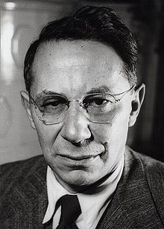
History
Tadeusz Reichestein and colleagues were awarded the Nobel Prize for in 1950 for their work on the hormones of the adrenal cortex.
Cortisone was isolated by them.

Slide 5
Introduction
A class of steroid hormones produced in the adrenal cortex.
Structurally and Pharmacologically similar to endogenous cortisol
Involved in the
Stress response
Immune response
Regulation of inflammation
Carbohydrate and protein metabolism
Blood electrolyte levels
Behaviour

Slide 6
Cholesterol
Pregnenolone
Progesterone
11-deoxycorticosterone
Corticosterone
18-hydroxy-corticosterone
Aldosterone
Corticosterone

Slide 7
Mechanism of action of steroids
Not water soulble.
Travels bound to protein carriers.
Target cell-Dissociates from carrier. Moves through plasma membrane.
Forms hormone –receptor complex in cytoplasm
Nucleus-binds DNA
Effects transcription (m RNA) →specific proteins
Some actions are independent of DNA interaction (eg-vasodialatation)

Slide 8
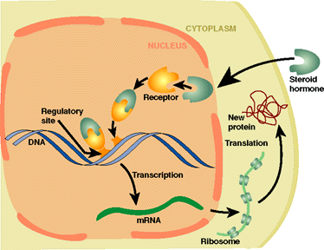

Slide 9
Metabolism of steroids
By cytochrome P450 oxidase
Bile acids are the final product

Slide 10
Classes of corticosteroids
4 classes based on chemical structure
Group A-Hydrocortisone,Hydrocortisone acetate
Group B-Triamcenelone acetonide, Budesonide
Group C-Betamethasone,Dexamethasone
Group D-Hydrocortisone 17-butyrate, Betamethasone

Slide 11
Routes of administration of corticosteroids
Topical-Skin, eye, mucous membranes
(Nasal mucosa,sinuses,bronci,lungs)
Local injection-intraarticular
Oral (prednisone, prednisolone)
Parentral

Slide 12
Actions of hydrocortisone
Mineralocorticoid effects
Glucocorticoid effects

Slide 13
Mineralocorticoid effects
Increased retention of sodium by the renal tubule
Increased excretion of potassium in the urine

Slide 14
Glucocorticoid effects
Carbohydrate metabolism-Increased gluconeogenisis,Hyperglycaemia, Glycosuria
Protein metabolism-negative nitrogen balance with muscle wasting,
Osteoporosis, delayed wound healing.
Fat deposition increased

Slide 15
Glucocorticoid effects contd…
Inflammatory response depressed-Neutrophil and macrophage function depressed
Allergic response suppressed
Anti vitamin D action
Reduction of hypercalcaemia (Sarcoidosis, Hyperparathyroidism)
Urinary calcium excretion increased

Slide 16
Hydrocortisone
The principal naturally occurring steroid
Oral /I.V. /intra-articularly
The I.V. form is given for rapid effect in emergency (deficiency,allergy or inflammatory disease)

Slide 17
Prednisolone
Biologically active
Mainly anti-inflammatory(glucocorticoid)
Little sodium retaining activity

Slide 18
Triamcinolone
Fluorinated corticosteroid
No mineralocorticoid activity
May cause muscle wasting, anorexia, depression

Slide 19
Fludrocortisone
Great sodium retaining effect
Little anti-inflammatory action
Hormone replacement therapy- aldosterone where the adrenal cortex is destroyed(Addison’s disease)
Used in autonomic neuropathy-for volume expansion (MSA)

Slide 20
Beclomethasone and budesonide
For bronchial asthma-inhalation route
Most of the inhaled dose is swallowed.
Can give a very low systemic plasma concentration.

Slide 21
Pharmacokinetics of steroids
Topical steroids (skin,lungs,joints) can cause enough absorption to cause systemic side effects.
In the blood 5% of the steroids are carried free(active form).The rest is bound to transcortin.
Hence steroid dose should be reduced in low albumin states and liver disease.

Slide 22
Indications for use of steroids
Acute severe asthma
Exfoliative dermatitis and pemphigus
SLE,Polymyalgia rheumatica,giant cell arteritis,dermatomyositis
Acquired haemolytic anaemia
Severe allergic reactions
Organ transplant rejection

Slide 23
Indications contd..
Rheumatoid arthritis
Ulcerative colitis and proctitis
Crohn’s disease
Nephrotic syndrome

Slide 24
Reducing hypothalamo/pituitary/adrenal suppression
Single daily dose –early morning
Alternative day schedules
Short courses
Mega doses far apart

Slide 25
Side effects of steroid treatment
Usually follow prolonged administration
Cushing’s syndrome
Diabetes mellitus
Proximal myopathy
Osteoporosis
Avascular necrosis of bone
Spread of infection and atypical features

Slide 26
Side effects of steroids contd…
Peptic ulcer and haemorrhage
Pancreatitis
Depression,psychosis,insomnia
Posterior subcapsular lens cataract, glaucoma
Growth retardation in children-esp. if treatment exceeds 6 months.

Slide 27
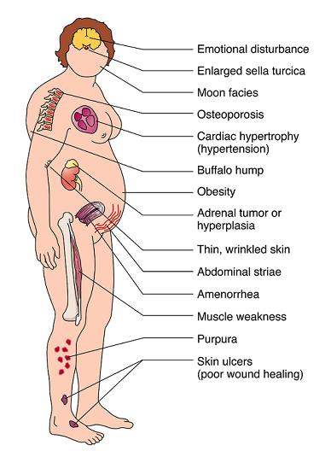

Slide 28
Precautions / chronic steroid therapy
Use the minimum dose to get the desired effect
Patient education
Carry a card containing details of therapy
What to do if they intercurrent illness or other severe stress-double the dose & tell the doctor
What to do if they miss a dose- take the dose as soon as possible
Vomiting-may require parentral administration

Slide 29
Precautions contd…
Major operations-hydrocortisone 100-200 mg i.m./ i.v.with premedication and repeated 6 hrly for 24-72 hrs.
Minor operations-hydrocortisone 20 mg by mouth before and after surgery.

Slide 30
Cautions
Used only for serious reasons in patients with
Diabetes
Mental disorder
Peptic ulcer disease
Tuberculosis
Epilepsy
Hypertention/heart failure

Slide 31
Contraindications
Topical corticosteroids in eye inflammation due to herpes virus
Florinated steroids in diabetes
Systemic fungal infections

Slide 32
Acute adrenocortical insufficiency
Also known as addisonian crisis
A MEDICAL EMERGENCY
100 mg of hydrocortisone on suspicion
Infusion of 0.9% NaCl & second 100 mg of hydrocortisone added to first litre.
Hydrocortisone 50-100 mg given every 6 hrs
Initiate oral dose of steroids
Treat cause

Slide 33
QUIZ
Mode of action of steroid hormones include
a) 2nd messenger
b) Modification of enzyme activity
c) Stimulation of DNA replication
d) Stimulation of RNA transcription
e) Inhibition of protein synthesis

Slide 34
Tapering
< 3 weeks- not necessary
>3 weeks-Tapering needed (Depends on dose, age and condition)

Slide 35
Answer- D

Slide 36
Steroid hormones travel in blood attached to protein carriers
a) True
b) False

Slide 37
Answer -a

Slide 38
Steroid hormones are water soluble
a) True
b) False

Slide 39
Answer- b

